Slide 1
Normalization
Normalization
A step by step process to minimize redundancy and remove unnecessary duplication of data to make the database more efficient and error free.

Slide 2
Normalization
Why Normalization ??
Domain Constraints
Assuring that there are no illegal values within a domain (set) of attributes
Entity Integrity
Assuring that almost every relation has a primary key
Assuring that every primary key is valid
Assuring that every primary key is NOT NULL

Slide 3
Normalization
Normalization is the formal process of determining which attributes should be grouped together in a relation
A method to validate the logical design (e.g., ERD)
A Tool to improve the logical design
Satisfaction of certain constraints
Avoidance of unnecessary data duplications
The process of Decomposing relations with anomalies to produce smaller, well-structured relations

Slide 4
Normalization
Why Normalization ??
Referential Integrity Constraint
Assuring that consistency between relational rows is maintained
Basic Rule Stating
If a foreign key exists in one relation, it MUST be
A Primary Key in another relation

Slide 5
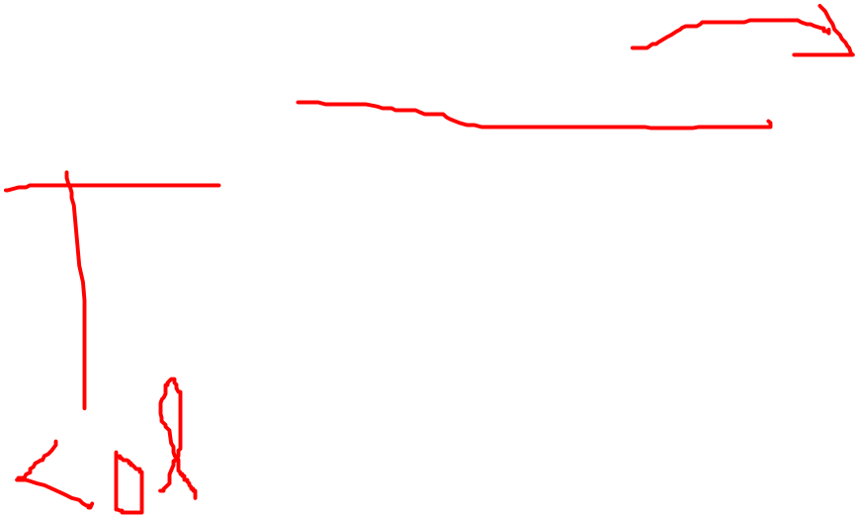
Normalization
Normalization Steps
First Normal Form
(1NF)
Removal of repeating groups (multi-valued attributes) so that there is a single value at the intersection of each row and column
Refer to the table HOSPITAL
“Each patient can have only one primary physician.”
Our first solution to this was not a very good one:
Put PatID in the Physician database

Slide 6
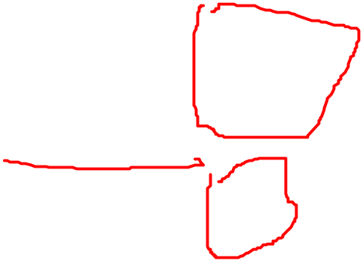
Normalization
The lay-out (for some of the attributes) then became:
PhysID
Name
PatID₁
PatID₂
PatID₃
• • •
PatID_{N}
111
Ali, Dr
901
902
908
• • •
112
Zia, Dr
915
.
.
• • •
113
Kiani, Dr
968
941
.
• • •
Or (in tabular lay-out):
PhysID Name Patient
111 Ali, Dr 901
902
908
112 Zia, Dr 915
113 Kiani, Dr 968
941

Slide 7
Normalization
Solution#1 make table according to PatID
PhysID
Name
PatID
111
Ali, Dr
901
111
Ali, Dr
902
111
Ali, Dr
908
112
Zia, Dr
915
113
Kiani, Dr
968
113
Kiani, Dr
941
NOTE: PatID does NOT repeat in a record
(There are NO Repeating Groups)

Slide 8
Normalization
• A Table is said to be in 1NF if:
There are no repeating groups

Slide 9
Normalization
Naturally, we can see that there are problems:
PhysID
Name
PatID
111
Ali, Dr
901
111
Ali, Dr
902
111
Ali, Dr
908
112
Zia, Dr
915
113
Kiani, Dr
968
113
Kiani, Dr
941
In order to identify a record, we need to use a combin-ation of PhysID AND PatID
Our Primary key is no longer unique

Slide 10
Normalization
Problems!!!
• Unnecessary duplication
• Increased probability of entry errors

Slide 11
Normalization
Second Normal Form
(2NF)
The relation must be in 1NF AND any of the following Conditions exists:
The primary key consists of only 1 attribute (column)
No non-key attributes exist
(all of the non-key attributes are components of the primary key)
Every non-key attribute is functionally dependant upon the full set of primary key (composite key) attributes

Slide 12
Normalization
The Primary key key consists of only 1 attribute
In our Physician Relation
PhysID
Name
PatID
111
Ali, Dr
901
111
Ali, Dr
902
A record Can only be Uniquely identified ONLY through the composite key PhysID, PatID
We could have specified our fields as:
PhysID
Name
PatID

Slide 13
Normalization
No non-key attributes exist
(all of the attributes are part of the primary key)
Consider the (Rearranged) Physician table fields:
PhysID
PhysName
PhysAddr
PatID
Input Clerk Name
111
Ali, Dr
H-9, Isl
901
Erum
111
Ali, Dr
H-9, Isl
902
Nida
112
Zia, Dr
S Town, Rwp
915
Erum

Slide 14
Normalization
Every non-key attribute is functionally depended upon the full set of primary key attributes
Consider the (Rearranged) Physician table fields:
PhysID
PhysName
PhysAddr
PatID
PatName
PatAddr
5
Bush, Georgia
23 Mesa St.
B013
Bob, Billy
111 E Street
In the above table:
PhysName and PhysAddr are functionally dependent on the key field PhysID (but NOT on PatID)
PatName and PatAddr are functionally dependent on the key field PatID (but NOT on PhysID)
There is a Partial Functional Dependency

Slide 15
Normalization
How do we convert to 2NF ??
Consider elimination if the attribute is not necessary
(Non-key attributes)
Decompose the relation into one (or more) relations that satisfy one (or more) of the conditions needed for 2NF
We already know (in our case) that PhyID should be placed in Relation Patient as a Foreign Key
(Since there is a 1:M relationship between Physician and Patient)

Slide 16
Normalization
If we now look at our relations, we might see:
Physician Table Attributes/Fields
Patient Table Attributes/Fields
1
PhysID
PatID
Name
Name
Street
Street
City
City
State
State
Zip
Zip
M
PhysID
Which is (almost) how we laid-out the relationship previously
RX Needs

Slide 17
Normalization
Notice that all of the conditions for 2NF have been met:
The primary key consists of only 1 attribute
(PhysID in table Physician; PatID in table Patient)
Every non-key attribute is functionally depended on the primary key
Physician(PhysID, Name, Street, City, State, Zip)
Patient(PatID, Name, Street, City, State, Zip, PhysID, RX Needs)

Slide 18
Normalization
Third Normal Form
(3NF)
The relation is already in 2NF
No Transitive Relationships exist
A Transitive Relationship is a functional dependency between two (or more) non-key attributes
Consider our Patient Relation, which might appear as:
PatID
Name
Street
City
State
Zip
PhysID
RX Needs
123
Cher
1st
LA
CA
9
5621
Psych
234
YoYo
Main
NY
NY
7
9277
Opth
345
Dr. J.
E
LA
CA
9
5621
Psych
456
X
Elm
Arl
TX
6
7733
Derm

Slide 19
Normalization
Third Normal Form
(3NF)
IF a physician can have only one specialty, then the field RX Needs is defined by PhysID
PatID
Name
Street
City
State
Zip
PhysID
RX Needs
In other words, RX Needs is transitively dependent upon PhysID
(Again, assuming each Physician has a single specialty)

Slide 20
Normalization
SO ?? If there is a functional dependency between PatID and their RX Needs, then we need that information, don’t we ??
Yes
--- BUT ---
If this is the ONLY relation we have, then the only way we have of knowing what specialty a physician has is to determine it vis-à-vis a Patient’s treatment needs
Operationally, transitive dependencies can cause severe maintenance problems
Such as ??

Slide 21
Normalization
Transitivity Anomalies
Insertion Anomalies
Suppose that a new physician is assigned to a specialty (e.g., Pediatrics). Until a patient is assigned to that physician, we have no way of knowing that physician’s specialty
Deletion Anomalies
If a Patient is deleted from the relation, and that is the only Patient a Physician has, we lose information about the Physician
Modification Anomalies
If a Patient is deleted from the relation, and that is the only Patient a Physician has, we lose information about the Physician

Slide 22
Normalization
How do we convert to 3NF ??
Simply remove the dependency, as we originally did
Our new relations would appear (as before) as:
Physician Table Attributes/Fields
Patient Table Attributes/Fields
1
PhysID
PatID
Name
Name
Specialty
Street
Street
City
City
State
State
ZipCode
M
ZipCode
PhysID

Slide 23
Normalization
Boyce-Codd Normal Form
(BCNF)
Consider the following relation
StudID
Major
Advisor
MajGPA
123
Literature
Shakespeare
2.89
234
Music
Beethoven
4.00
345
Physics
Newton
3.76
456
Music
Mozart
2.23
567
Music
Beethoven
3.25
678
Physics
Bohr
2.56
789
Literature
Eliot
3.33
The table is in 3NF since no functional dependencies exist between two (or more) non-key attributes
Major is NOT dependent on Advisor (Or vice versa)
Major is NOT dependent on MajGPA (Or vice versa)
Advisor is NOT dependent on MajGPA (Or vice versa)

Slide 24
Normalization
Boyce-Codd Normal Form
(BCNF)
HOWEVER, in the table, Beethoven appears twice
StudID
Major
Advisor
MajGPA
123
Literature
Shakespeare
2.89
234
Music
Beethoven
4.00
345
Physics
Newton
3.76
456
Music
Mozart
2.23
567
Music
Beethoven
3.25
678
Physics
Bohr
2.56
789
Literature
Eliot
3.33
If Beethoven were to quit and be replaced by Dr. Dre, we would have to make TWO different changes
(A modification anomaly)

Slide 25
Normalization
Boyce-Codd Normal Form
(BCNF)
To correct this condition, we might set up two tables:
StudID
Major
Advisor
MajGPA
AdID
Name
123
Literature
2001
2.89
1904
Dr. Dre
234
Music
1904
4.00
2001
Shakespeare
345
Physics
5332
3.76
3445
Eliot
456
Music
4662
2.23
4662
Mozart
567
Music
1904
3.25
5332
Newton
678
Physics
5604
2.56
5604
Bohr
789
Literature
3445
3.33
By simply changing Beethoven to Dr. Dre we have made all the changes necessary

Slide 26
Normalization

